Slide 1


What is Fueling the Seattle Housing Market? April 12, 2021 Joanne Gates, John-Francis Kraemer, and Somya Panda
The Seattle Supersonic Housing Boom
For Discussion Purposes Only

Slide 2
What is Fueling the Seattle Housing Market?
Has anybody noticed how ridiculously expensive housing is in Seattle?
What specific Seattle neighborhoods and surrounding towns have experienced the greatest housing boom in the past 10 years?
What are the underlying companies, asset types, and datapoints propelling the Seattle real estate market?
Is there a strong individual correlation between these datapoints and Seattle housing prices?
Is there a strong weighted index correlation of these datapoints and Seattle housing prices?
Can those datapoints be forecasted into the future?
Can housing prices in Seattle be predicted based on the future performance of these datapoints?

Slide 3
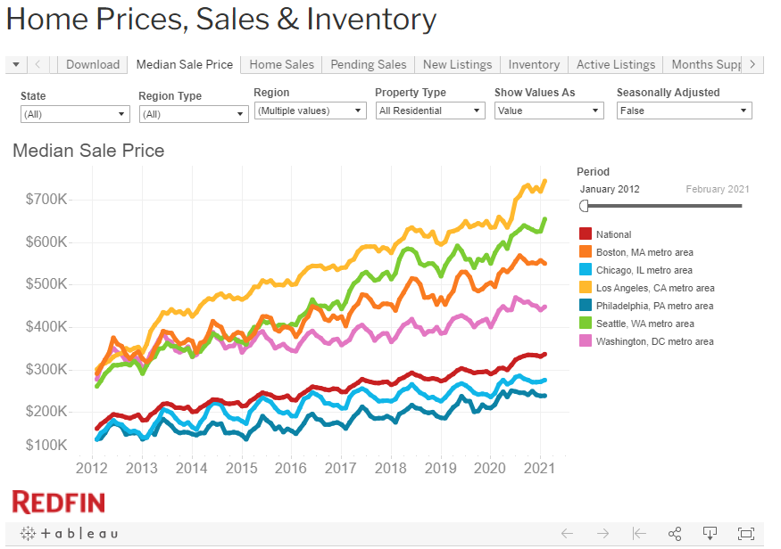
Seattle Housing Market – Housing Data
Research of historical housing prices by Seattle neighborhoods and surrounding towns
Pulled historical prices over the past 9 years (2012) from RedFin (https://www.redfin.com/news/data-center/)

Slide 4
Seattle Housing Market – Housing Data
Insert Mapbox Plot of Seattle

Slide 5
Seattle Housing Market – Assets/Datapoints
What are the underlying companies, asset types, and datapoints propelling the Seattle real estate market?
Researched largest publicly traded big tech employers in the Seattle area
Amazon, Microsoft, Tableau, Zulilly
Researched other asset classes
Gold, bond yields, Bitcoin
Pulled historical prices of those assets over the past 9 years and cleaned data
Used Alpaca, Capital IQ, US Treasury
Insert Returns of Assets

Slide 6
Seattle Housing Market – Correlation
Calculated individual correlation of [39] Seattle neighborhoods and surrounding town median housing prices by month over the past 9 years against the prices of Amazon, Microsoft, Tableau, Zulily, Gold, Bitcoin, 30-year Treasuries
Identified the assets with the highest correlation to historical median housing prices

Slide 7
Seattle Housing Market – Correlation
Insert Correlation Table

Slide 8
Seattle Housing Market – Correlation
Insert Correlation Charts

Slide 9
Seattle Housing Market – Correlation
Insert Correlation Charts –Heatmap Chart

Slide 10
Seattle Housing Market – Monte Carlo Simulation
TBD
TBD

Slide 11
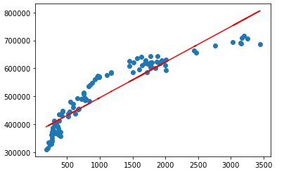
Seattle Housing Market – Linear Regression
Calculated linear regression on Amazon stock prices and median average Seattle housing prices
Imported new Panda libraries
from sklearn.linear_model import LinearRegression
import statsmodels.api as sm
Linear Regression Equation
y = m(x) + b
m = slope
b = intercept
x = Amazon stock price
y = Median housing prices
r² = coefficient of determination (correlation squared)¹
Note:
¹ The coefficient of determination is a statistical measurement that examines how differences in one variable can be explained by the difference in a second variable, when predicting the outcome of a given event

Slide 12
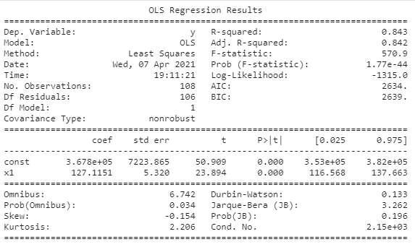
Seattle Housing Market – Linear Regression (Historical)
Linear Regression Equation
y = m(x) + b
m = 127.11
b = 367,756
x = $3,372.20 (close on 4/9/21)
y = Median housing prices (today)
r² = 0.84
y = 127.11 * 3,372.20 + 367,756
y = $796,396

Slide 13
Seattle Housing Market – Linear Regression (10 Years)
Linear Regression Equation
y = m(x) + b
m = 127.11
b = 367,756
x = [$] (10 years)
y = Median housing prices (10 years)
r² = 0.84
y = 127.11 * 3,372.20 + 367,756
y = [$]

Slide 14
Seattle Housing Market – Expected Housing Prices
Insert Mapbox Plot of Seattle for future prices

Slide 15

Questions

